Slide 1
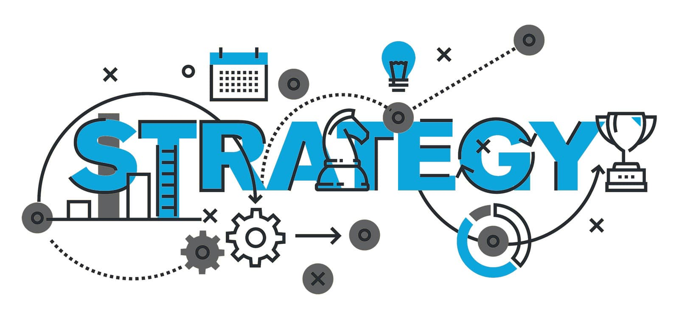
Product Management
Gestion de produit
Amenée dans les secteurs de programme
Brought to the Program Areas
UNCLASSIFED / NON CLASSIFIÉ
Notes:
Il y a beaucoup de perspectives différentes ET d’attentes de ce que la « gestion de produit » signifie pour les gens. Si vous avez une formation ITIL, ce n’est pas tout à fait ça. Si vous avez lu la série de livre IT Revolution ou le Open Group Digital Practitioner BoK, ce n’est pas toute à fait ça non plus. Gartner… n’en parlons même pas…
Ce que nous cherchons à faire, c’est d’amener la gestion de produit dans les secteurs des programmes gouvernementaux, expliquer POURQUOI c’est nécessaire, et QU’EST-CE qui change réellement (pour que ce ne soit pas des paroles en l’air quelque chose qui peut être réellement mis en oeuvere).

Slide 2
But
Nous cherchons à:
Fournir un nouveau type d’investissement à EDSC: le financement basé sur les produits
Fournir aux secteurs d’activité un encadrement pour une transition vers la gestion de produit
Pourquoi:
Livrer les Logiciels au rythme de la pertinence
Intégrer les stratégies d’affaires et TI
Libérer de la capacité interne vers l’innovation
Éviter le sous-investissement chronique dans l’infrastructure TI
Notes:
[transition] Ça nous a amené à fournir deux choses à EDSC:
[transition] Un nouveau type d’investissement finance basé sur les produits
Ceci parce que EDSC reconnait actuellement que trois types d’investissements: les biens, services acquis et projets (Source CFOB Guide to Building a Business Case: https://gpp-ppm.service.gc.ca/sites/pwa/ESDCKnowledgeRepository/All%20Documents/Guide%20to%20Building%20a%20Business%20Case.pdf)
Si un programme voudrait incorporer la gestion de produit dans une soumission au conseil du trésor, il n’y a actuellement pas de mécanismes qui existent pour se faire. Il doit suivre le cheminement d’un projet. Mais un projet se termine et cherche la certitude avant de commencer son exécution.
Une statistique de notre propre Centre de projet est qu'il faut, en moyenne, 1 291 jours pour COMMENCER la phase d'exécution d'un projet. Une organisation ne peut pas prétendre être agile s'il lui faut 3,5 ans pour commencer à exécuter
https://sara-sabr.github.io/ITStrategy/2021/05/18/problems-of-project-based-funding.html
[transition] Un encadrement pour une transition à la gestion de produit après la fin d’un projet
Cela existe déjà en partie. Par exemple, MyEMS (SAP) avec l'équipe PRE de la DGIIT
Mais les connaissances sur la façon de procéder et comment ça se rapporte à la gestion de projet ne sont pas largement disponibles
[transition] Il y a 4 raisons pour les quelles nous voulons faire ça:
[transition] Livrer les logiciels au rythme de la pertinence. « La Business » (c’est-à-dire, les programmes) se plaignent qu’on est trop lent et qu’il est trop fastidieux de traiter avec la DGIIT
[transition] Intégrer les stratégies d’affaires et TI. Il est actuellement extrêmement difficile de prévoir les besoins des programmes. De même, les Programmes ont de la difficulté à nous communiquer leurs besoins de manière adéquate. Vous avez probablement été doublement, voire triplement, invité à des réunions comptant plus de 70 participants, n'est-ce pas ? C'est un symptôme de la complexité à laquelle les programmes sont confrontés
[transition] Libérer de la capacité interne vers l’innovation. Nous ne cherchons PAS à réduire les coûts ici, nous cherchons à créer l'espace nécessaire pour des améliorations continues en réduisant CERTAINS du overhead que notre capacité interne gère actuellement.
[transition] et... éviter le sous-investissement chronique dans l'infrastructure TI. Un problème que même la MVP, en promettant une infrastructure moderne, n'est pas en mesure de résoudre.

Slide 3
Trois intervenants principaux d’impliqués
Responsable de programme
DPF
DPI
VU PAR
Responsable de programme
VU PAR
DPF
VU PAR
DPI
Notes:
[transition] Dans notre contexte de gouvernement fédéral, nous voyons trois principaux intervenants d’impliqués : le responsable de programme, le CFO, et le CIO.
[transition] Chacun perçoit l’autre d’une certaine manière. C’est normal, chacun a des règles différentes qui les gouverne, affectant leur comportement et leur perception.
[transition] Le responsable de programme est responsable de son rendement. Et EDSC a 50 de ses programmes
[transition] Le CFO et le CIO sont responsables des politiques générales (corporate, comme les 509 exigences politiques pour le CIO. Car à EDSC, le CIO est aussi l’agent responsable pour la cybersécurité).
https://sara-sabr.github.io/ITStrategy/2021/06/02/stats-digial-policy-instruments.html
[transition] Ces responsabilités « corporate » exigent de gérer des demandes importantes sur des ressources limitées et débordées (c'est-à-dire... notre personnel). Si les programmes ne considèrent pas les services internes comme une partie prenante, il leur est plus difficile de naviguer ces règles « corporate » et risquent de manquer d'importantes occasions d'apporter des changements, même modestes, à leur prestation.

Slide 4
La situation dans son ensemble
Programmes
Évalués par la Politique sur les résultats
Demande
Services
Internes
< 15% des services votés affectés aux projets
Budget total de la DGIIT
Projets utilisés pour compétitionner l’obtention des ressources limitées
Crédits votés
Crédits temporaires
Les responsables de programmes, la DPF, et le DPI se partagent la responsabilité pour les résultats
Notes:
[transition] Nous pouvons visualiser les relations entre les programmes et les TI comme un iceberg. Les programmes voient ce qui est au-dessus de l'eau et se demandent pourquoi c’est si lent à bouger.
[transition] Ben, parce qu’ils ne voient pas ce qui est sous la surface.
Dans la même veine, si ce qui se trouve sous la surface est trop profond ou s’il y passe trop de temps, on risque d'oublier que c’est ce qui se trouve au-dessus de la surface dont EDSC est tenu responsable devant le Parlement. [transition]
Et pour avoir des résultats, la livraison est importante.
Avec la nouvelle politique sur le service et le numérique, la prestation des programmes doit d’abord être numérique.
[transition] Les opérations d’affaires se transforment en opérations numériques. Un changement aux opérations numériques implique un changement aux logiciels. Augmentant la demande de services internes.
Cette relation entre les deux surfaces du même objet est décrite dans le Cadre des résultats ministériels (CRM). Le problème que nous rencontrons est que le CRM comporte un répertoire des programmes (décrivant les 50 programmes du ministère) et un élément appelé "Services internes". Bien que le CRM indique que les services internes sont de nature horizontale, cela peut trop souvent être interprété par les programmes comme "les TI ne me concerne pas".
[transition] C'est un problème. Si, dans leurs renouvellement périodiques, les programmes ne cherchent pas à obtenir un financement suffisant pour soutenir leurs opérations numériques, ça affecte leurs résultats. Et lorsque les demandes de financement au conseil du trésor reçoivent une réponse prévisible de réduction de budget, des décisions difficiles de priorisation doivent être prises. La façon dont on procède actuellement consiste à regrouper le travail en "projets" et à se faire concurrence pour obtenir ces ressources TI limitées.
Pour les services communs, la concurrence est FÉROCE. Un système de retraite peut être amené à s'engager et à coordonner des douzaines de projets en même temps (conformité aux règles d’accessibilité, workload migration, mise à niveau du serveur Windows, stabilisation de la dette technique, une amélioration d’affaire, un mandat législatif, BDM). Chaque projet a une grande portée de changement. Il peut devenir irréaliste pour les TI de gérer et de coordonner des engagements de cette envergure sur un seul système. De plus, si le Programme de pension n'a pas suffisamment investi dans son système de pension au cours des décennies, il souffre aujourd'hui d'un manque de souplesse qui affecte les résultats du Programme de pension.
GCPEdia’s Internal Services Portal: https://www.gcpedia.gc.ca/wiki/Internal_Services_Portal
Departmental Results Framework: https://dialogue/grp/WG6278300/SitePages/Home.aspx

Slide 5
Continuous Improvements vs Projects
FUNDING COVERAGE
RUN
Maintain Value
ENHANCE
Drive Value
Operate (Run)
Maintain Value
Enhance (Improve)
Drive Value
Innovate (Change)
Create Value
INNOVATE
Create Value
Operation and Maintenance
Run
Continuous Improvements
Small Growth
Innovate
Large Growth
Transform
A-Base Funding
B-Base Funding
Slide inspired from Jan 2021 presentation by MyEMS (SAP) CoE
Notes:
[transition] We seek to separate continuous improvements from Projects.
And by doing so, allow more autonomy to teams to perform certain small growth activities (e.g. typically improving existing business processes, enhancing existing modules, addressing the SA&A’s residual risks).
Projects still exist. When there is a certain size of change needing to be managed (such as coordinating changes across multiple products, or when there’s a certain threshold of business operation modification needed to be change managed). Projects are also the main instrument Programs use to seek funding for such change.
That scale of change differentiating product enhancements vs projects is yet to be determined.

Slide 6
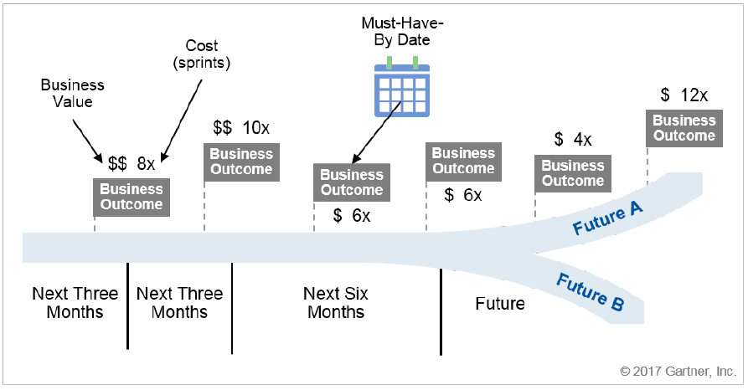
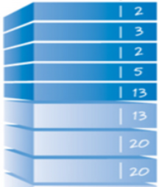
The Roadmap as the Plan
Project B
Project D
Project A
Project C
Backlog
Release Plan
Release Plan
Release Plan
Release Plan
Notes:
[transition] To organize these series of continuous improvements and project-specific requests affecting a particular product, the Product Roadmap is used. It’s the main negotiation instrument a Product Manager uses. It becomes the basis of accountability.
[transition] Projects compete against each other to change the product’s roadmap. Determining what change is more important at a point in time. Parallel projects, therefore, handle the coordination of changes to be applied on multiple different product roadmaps.
[transition] Those changes make up the product’s backlog
[transition] which informs the release plan on the product’s time horizon.
The Roadmap can and most likely will change depending on events. Because of reality. Parallel projects schedules would be expected to handle this change.
This all raises the importance of having strong Product Managers. We think this role will require a broad set of skills, especially leadership, as well as having both business and corporate acumen.

Slide 7
What a Product Management Framework provides
IITB Directive on Product Management
IITB Standard on Product Management
IITB Standard on Financial Coding for Product Management
IITB Procedures on Product Management
Notes:
[transition] The Product Management Framework we seek to produce comprises of:
[transition] A Directive.
To set IITB’s direction on how investments classified as “product”, by the EPMO, and how transitions from project to product are to be managed by the branch. This includes, for examples, roles and responsibilities, adherence to a set of standards, and consequences of non-compliance.
BTW, common definitions (e.g. “product”, “product manager”, “product owner”) is what the Project and Programme Management Practice Working Group is doing, lead by the EPMO.
[transition] Two standards: one on Product Management, and one on Financial Coding for product management
The first is to set IITB’s mandatory process for a consistent application of product management. It includes, for example, Technical Roadmapping Requirements, Budgeting agreement and securing sources of funds, corporate reporting requirements, Governance. Some of those standards would most likely point to existing processes.
The Financial Coding one is because we currently do financial coding as “run” or “projects”. Continuous improvement activities will require establishing financial coding and structure for activities performed under a “product status”.
[transition] Procedures on Product Management
This to guide stakeholders in navigating IITB’s Governance throughout the Product Development Life Cycle. For example: how to “seeking product status”, roles of each IITB corporate committees (and potentially updating their Terms of Reference).

Slide 8
A Branch Initiative to get things started
1
2
3
Job Bank
MyESDC
Notes:
[transition]
A Framework is but this: a set of documents. Change does not happen by producing documents.
We launched an 18 month Branch Initiative to produce the framework and evaluate it against 2 candidates: Job Bank and MyESDC Mobile App.
The Branch Initiative involves only salary contribution.
We know we are not going to get it right the first time, so the evaluation is to inform us of changes needed after having tried it.
One outcome of the BI is to inform a greater change management plan in bringing a Product Management Operating Model to ESDC. A lot of activities in this area are lead by EPMO.
The BI has 3 phases:
[transition] Phase 1 is the production of the framework. We seek engagement from 9 IITB divisions as it can’t be produced from an ivory tower. This phase will also seek contributions from CFO and TMB (Business Architecture).
[transition] Phase 2 is the evaluation of the framework. We’ll be following the 2 candidates in using the framework next fiscal year.
[transition] Phase 3 is updating the framework with the lessons learned and informing a greater change management plan in bringing a Product Management Operating Model to ESDC. A lot of activities in this area are lead by EPMO.

Slide 9
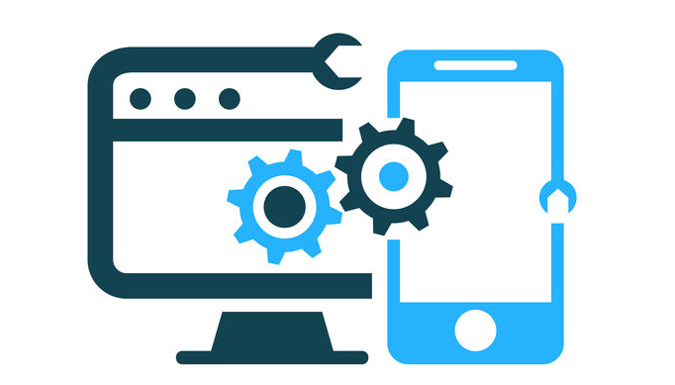
Links with other initiatives
DevSecOps
BDM
Technical Debt Remediation
IITB Way Forward Phase 2
Notes:
[transition] Other initiatives are currently under way that seeks similar goals. We seek to either leverage them or contribute to them.
[transition] DevSecOps: because a product management expects a certain cadence of delivery to be sustained (typically a release within 3 months), it favours the adoption of DevSecOps to maintain pace of relevance and continuously address cyber security risks. And we do mean SecOps, because security at runtime.
[transition] Tech Debt: Transitioning to product management is expected to require agreement between a Program Official and the CIO to fund product teams allowing them to address technical debt as part of their continuous improvement activities. In addition, we suggest three key metrics that links technical debt to the product team’s velocity and the product’s quality (here, we point to the APM+ program).
[transition] BDM: BDM’s scope is transformation, which will end. It does not include solving the sustainability challenge post-Programme.
Product Management compliments BDM’s transformational agenda by preparing IITB to transition BDM’s Digital Solutions to managed products.
[transition] And Phase 2 of the IITB Way Forward: The recent IITB Re-Org is based broadly on the Product Management Model, with a concept of a portfolio centric delivery environment supported by common services.

Slide 10
Sommaire
Le passage au numérique nous oblige à adapter nos méthodes de planification et de gestion des investissements
Fournit un financement durable sur un horizon temporel
S’adapte aux priorités changeantes de l’organisation
Accorde plus d’autonomie aux équipes
Augmente la cadence d’amélioration des services
Produit
Merci
Notes:
[transition] En somme.
À mesure que EDSC numérise ses opérations d’affaires, les logiciels deviennent essentiels. La gestion des produits est la direction que prend l'industrie. Elle commence à devenir la norme au point que le bureau du CIO du secrétariat du trésor, vous le savez probablement déjà, a créé un groupe de travail au niveau DG pour étudier comment elle peut être mise en œuvre dans le gouvernement, et la dernière mise à jour du Plan stratégique des opérations numériques 2021/24 mentionne la gestion des produits dans deux piliers stratégiques.
https://www.canada.ca/en/government/system/digital-government/government-canada-digital-operations-strategic-plans/digital-operations-strategic-plan-2021-2024.html
[transition] La gestion de produit amène:
Un financement durable aux équipes. Leur fournissant une stabilité
[transition] Une adaptation aux priorités changeantes. Parce que la feuille de route d’un produit évite de rester trop longtemps dans une phase de planification, des ajustements peuvent être apportées sans perdre une trop grande partie de l'investissement. Elle réduit aussi les impactes de collisions de projets qui peuvent bloquer la livraison.
[transition] Accorde plus d’autonomie aux équipes en leur délégant certaines authorités et en évitant trop de cuisiniers qui pourraient gâter la sauce
[transition] Augmente la cadence d’améliorations des services en se concentrant sur les résultats, plutôt que sur les documents de planification d'entreprise.
Je finie en clarifiant 3 choses :
Pour l’instant, on cible les produits des Programmes, moins ceux Corporatifs (c’est-à-dire moins, par example, AppGate ou les produits nécessaires à un service de signature numérique). C’est pour partir quelque part. Et les programmes sont la raison d’être de ce ministère. Une ambition derrière notre approche est de pousser les Programmes à faire la priorisation difficiles de leurs fonds limités, nous permettant ainsi de nous concentrer sur nos fonds corporatifs TI.
Il est compris que des produits d’envergure, comme un système de gestion des bénéfices, se voudra gérer les demandes de plusieurs Responsables de Programmes (par exemple, Le programme d’Assurance Emploi à lui seul équivaut à 9 DGs). Nous voulons commencer avec quelque chose de plus simple comme Job Bank puis augmenter l’échelle (scale up).

Slide 11
Draft definition of “Product”
A business output that is the result of a project used for continuous improvement on an existing solution or service, the value of which is realized and delivered as part of ESDC's Program mandate, services external or internal stakeholders, and delivers or improves business capabilities or client experience.
Draft definition from the Project and Programme Management Practice WG

Slide 12
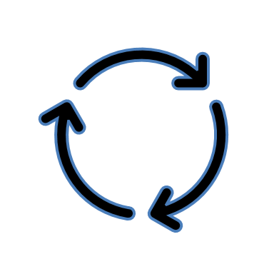
e.g.
Bi-yearly
e.g. Every 3 years or TB sub time horizon
New
Transition from Project to Product
Product Status Review
Changes in Product
Review
End of Life
Existing Artefact / Activity
Project Closure
Product Status Creation
Enterprise Alignment
Continuous Improvements
Update
Existing Process
Decommission
Stage 5
Project Closure
Step 1
Intake
Step 2
Initiation and Review
Step 3n: Release n
(Managing a Release)
Step 3n+1: Release n+1 (subsequent releases)
Step 4
Decommission
Governance → | MPIB / DGPOC | Sponsor & DGPOC/MPIB (depends on Budget amount) | Sponsor & DGPOC/MPIB (depends on Budget amount) | Sponsor | Sponsor | Sponsor | DGPOC/MPIB | Sponsor & DGPOC/MPIB
Responsible ↓ | Product Gating Artefacts
Product Manager |  | Product Brief Multi-Yearly budget Value Stream Map Cadence (schedule) Architecture Boundaries Product Governance Structure (Board) Source(s) of funds | Step-Base Product Roadmap Multi-Yearly Budget Key Product Metrics Conceptual Target Architecture Architecture Boundaries Benefits Realization Plan IRBV Archiving Checklist | Approval to Deploy Acceptance Report Product Workload Metrics | Approval to Deploy Acceptance Report Product Workload Metrics | Key Product Metrics | GO TO STEP 2 | Approval to Decommission Product Closure Report IRBV Archiving Checklist
FMA |  | FMA Attestation | FMA Attestation | FMA Attestation | FMA Attestation |  |  | FMA Attestation
Responsible ↓ | Product Supporting Activities
Product Manager |  |  | EARB review SA&A review | Produce Costing Tool Produce Release Schedule Evaluate Architecture Boundaries Change Management Risks and mitigation | Produce Costing Tool Produce Release Schedule Evaluate Architecture Boundaries Change Management Risks and mitigation |  |  | Produce Costing Tool Produce Schedule Document Lessons Learned Change Management
Product Owner |  |  |  | Release Scope Step-Base Product Roadmap (update) | Release Scope Step-Base Product Roadmap (update)
Product Team |  |  |  | Backlog grooming Evaluate Previous Release | Backlog grooming Evaluate Previous Release
Project Artefacts
Architecture Boundaries = Alignment to PIP and Business Capability Model, Privacy Impact Assessment, Statement of Sensitivity, Statement of Acceptable Risk, Algorithmic Impact Assessment (if AI used)

Slide 13
Product Roadmap as the Investment Plan
The Product Roadmap is the plan and basis of accountability
A Business Outcome is a mini-business case (1 pager) and the definition of success for a particular step
Funding based on priorities, not historical spending levels
The Roadmap can and will reprioritized or add new business outcomes to the roadmap due to experience gained with the product and to changes in departmental priorities
A roadmap is reality. Parallel projects feed Roadmap backlogs and will adjust based on the roadmap’s changes.
The path towards an outcome is not straight¹
Requires moving towards Continuous-type of ATOs and Monitoring²
Requires LOBs to accurately define business outcomes (promotes CDO/BAAO partnership)
¹ Requires a different set of metrics than project schedules due to iterative, empirical evidence seeking, process
² NIST and ITSG-33 do not have continuous types of controls. Need to innovate while remaining in compliance.
Notes:
Cost Estimates
Values the use of teams as a unit to calculate costs. Simplifies the cost estimates if 2 teams (@ $1M/year each) x 5 sprints of 2 weeks = $384,615
Product team focuses on the ROADMAP. Side project can influence the roadmap but when the roadmap changes, side projects need to adapt. I.e. there are no Change requests. Instead, there are Change events that projects need to handle.
WLM, Windows Server Upgrades, A11y Compliance, Tech Debt, Business Enhancement, BDM, etc. require to deal with change.

Slide 14
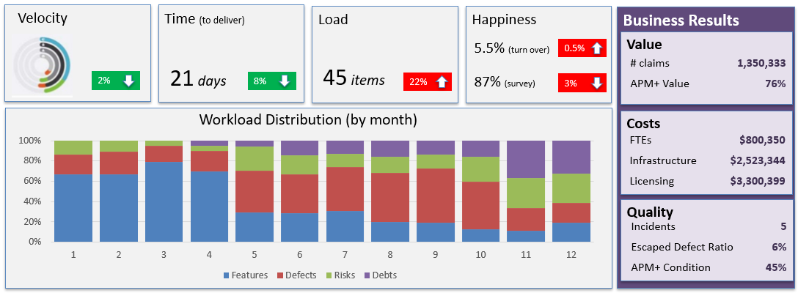
3 Key Metrics to provide assurances
Produced by the Product Team
Consumed by the Product Team, Business Sponsor, and Governance (DGPOC/MPIB)
Demonstrates progress towards Roadmap’s business outcomes
Includes Health Diagnostic metrics to address potential velocity issues (e.g. creeping technical debt)
Includes Workload distribution for transparency on focus
Includes Business Results which is ultimately what the Business and CFO cares about
Tied to a Program’s results
Business Results identification would benefit from strong collaboration with the CDO and BAAO
Notes:
Product development isn't the Wild West and teams do have metrics to measure how they are doing. These metrics focus on results and the trajectory toward objectives, rather than productivity
measures such as lines of code per day.
The team primarily shows its progress to the business through demonstrating working software and improvements with each iteration. It is responsible for its metrics and reporting them
to stakeholders. Metrics are reviewed at least at every sprint with business stakeholders as part of the retrospective. They may also be reported up to higher levels of governance as needed.
Sources:
Gartner G00338491 - Tell the CFO the Agile Team Isn't Asking for a Blank Check
Gartner G00309193 - Use the Right Metrics in the Right Way for Enterprise Agile Delivery
IT Revolution’s Project to Product book
Workload Distribution
Features: (visible to users) delivers New Business Value, pulled by Users, e.g. Epic, user story, requirement
Defects: (visible to users) delivers Quality, pulled by Users, e.g. Bug, incident, breaking change
Risks: (NOT visible to users) delivers Security and Governance, Compliance, pulled by Security and risks officers, e.g. Vulnerability, regulatory requirement
Debts: (NOT visible to users) removes impediments to future delivery, pulled by Architects, e.g. API addition, refactoring, infrastructure automation
Flow Metrics
Velocity: Number of flow items done in a given time. E.g. number of debts item resolved for a particular release.
Time: Time elapsed from when a flow item enters the value stream (state = active) to when it is released to the user (state = done). E.g. Time it takes to delivery a new feature to a user from when it was accepted.
Efficiency: The proportion of time flow items are actively worked on to the total time elapsed. I.e. a decreased efficiency is indicative of dependencies between teams waiting on others.
Load: Number of flow items with state = active or waiting (i.e. Work in Progress). Loads that exceed certain threshold adversely impacts velocity.
Business Results Metrics
Value: Benefit to the business the value stream produces. In the private sector, these would be tied to profit. However in the public sector, this metric changes between Digital Products and needs to be aligned to the ESDC Business Capability, Service, or Program’s desired outcomes that the Digital Product enables. The APM+ Business Value health indicator is included as well.
Cost: Cost of the Digital Product to ESDC. This includes the Value Stream’s staff salary, consultants, contractors, infrastructure, licensing, cloud subscriptions
Quality : The quality of the Digital Product perceived by the end user (e.g. escaped defects, tickets filed) and the APM+ Technical Condition Health indicator.
Happiness: Engagement of the staff working in the Value Stream (employee’s Net Promoter Score, ESDC HR Surveys, Public Service Employment Surveys).

Slide 15
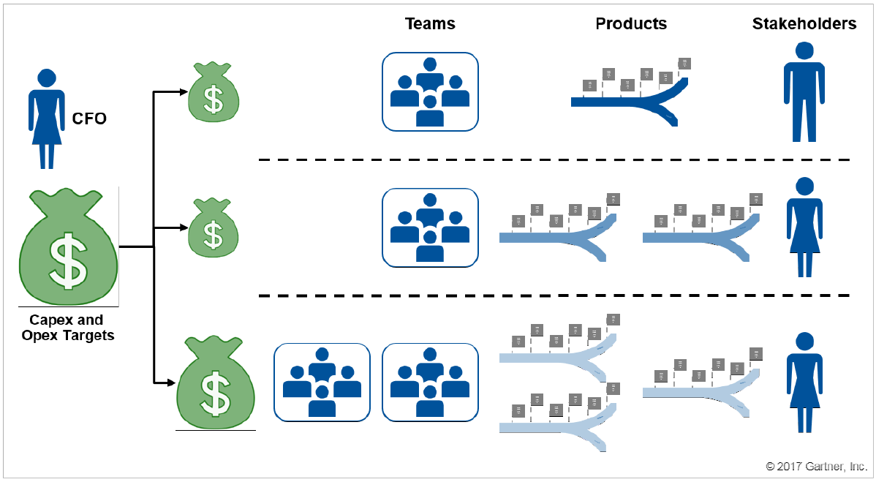
Portfolio Management & priority-based funding
CFO responsible for Budget, proportional to departmental and government priorities
Program Official responsible for fund according to her priorities
Program Official
(roadmaps)
CFO defines budgets based on ESDC priorities
Program Officials decide where the funds are allocated
Re-distribution of funds establishes new priorities for value stream teams
Increasing a product’s budget requires CFO engagement
Product A
Product B
Program’s portfolio Budget
Product C
Notes:
Instead of allocating spend to projects based on each project budget for the period, allocate it to products (or groups of products) for the period.
The allocation determines how many people and teams can work on any given product or product family. The job of the governance body is not to approve a project budget, but to
decide how to allocate the resources. As one CIO put it, "How much money should we be spending on this problem at this time?“
Gartner G00338491 - Tell the CFO the Agile Team Isn't Asking for a Blank Check

Slide 16
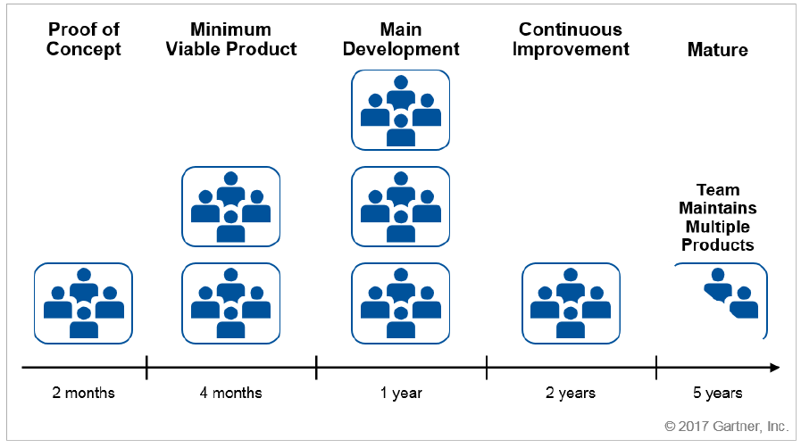
Value Stream Size vary during product’s life cycle
If product is a priority, more teams can be added to sustain development
Once product matures, work reduces to the minimum required until retirement
Value Stream team(s) work on more than one product
Products include exit strategies for value stream teams (e.g. when demand diminishes, teams are allocated to other products)
Pool of teams

Slide 17
Product’s Architectural Boundaries
(established at product status creation)
Reviewed as part of:
Product Roadmap’s periodic review
Internal Governance trigger (e.g. change in security classification, change in information collection)
Business Context:
Alignment to the Program’s Information Profile (PIP)
Alignment to the Business Capability Model¹
Accessibility Checklist
Information Profile:
Privacy (PIA, including retention & disposition),
Security (SoS, SAR),
Ethics (AIAs)
Technology Standard:
unacceptable technical stacks (in containment or retirement)
Product team responsible to produce the product’s target conceptual target architecture endorsed by EARB. Services from Solution Architecture of benefit to increase confidence.
Note 1: Application Architecture domain purposefully not included to provide more autonomy to product teams, accelerate delivery, and allow Enterprise Architecture to move towards a more strategic position (“doing the right things”). Promotes the use of Reference Architectures, inventory of re-usable open software products, and communities of practice (“doing things right”).
Note 2: Security Architecture a component of all architectural layers. Security compliance residual risks gets added to the product backlog and is part of daily work for the product team to remediate.
PIA = Privacy Impact Assessment SoS = Statement of Sensitivity SAR = Statement of Acceptable Risks AIA = Algorithmic Impact Assessment
Existing Artefact / Activity
¹ Using Enterprise Requirements Management at the business level
Existing Process

Slide 18
Value Stream
Definition
The individuals, irrelevant of where they fit within the org structure, that are part of the product delivery and operation (a grouping of cross-functional teams)
Handoffs greatly reduced if all individuals are under a single “Product Manager”
An implementation of the IITB SDLC
Value Stream (People)
Ideate
Create
Release
Operate
Planning
Engineering & testing
Release Mgt
Support, Monitoring, Ops

Slide 19
Infrastructure
(e.g. SSC, Cloud)
Tech Stack s/w Licences
Product A
Labour
(salary / non-salary
Direct Costing
Product B
CATS Codes
Source i
(e.g. TB sub i)
FMAS Documents
Allocation
Source ii
(e.g. EI Program)
Indirect Costing
Product Team Salary & non-salary
Corp Licences
(e.g. SaaS, s/w)
Common Cloud Services
Source iii
(e.g. CRF)
Real Estate
Common SSC services
Legend
Employee Benefits
Equipment
(e.g. laptops)
Cost Pool
Indirect costs shared by more than one cost object
Corporate Services
(e.g. Arch, Security Assessment)
Cost Object
Direct cost that is unequivocally attributed to a single cost object
Source
Source of fund that can pay for the product costs
Notes:
Common Cloud Services e.g.: networking (pipes)
Public sector organizations are required to report externally on the full cost of every element in their program architecture. In the meantime, such organizations also require multiple views of costs to manage effectively. The way to address these needs is through a mix of direct and indirect costing techniques.
The various views of cost are called cost objects - entities (activity, output, organization, program, client/target group, outcome, project) for which costs are being computed.
The costing system attributes a direct cost to its cost object and classifies indirect costs into cost pools through the correct financial coding of a transaction, using direction provided by the GC Chart of Accounts policy.
An example of a direct cost (definition: a cost that is unequivocally attributed to a single cost object) is the cost of a chemical used in a lab to conduct research in support of a particular organization or program.
An example of an indirect cost (definition: a cost that is shared by more than one cost object) is the cost of a photocopier used by multiple programs/organization. The assignment of indirect cost pools to cost objects is facilitated using existing operational data that managers already consider important and relevant – in the photocopier example, statistics can be obtained on how many copies were made by each organization/program over a particular time period.

Slide 20
Product Managers

